Slide 1


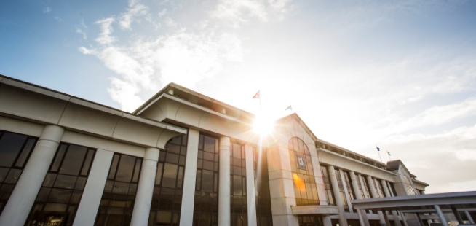
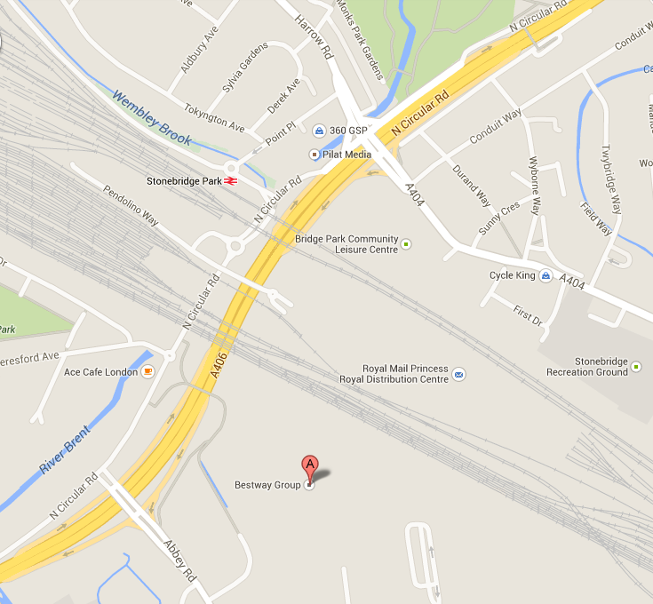


Bestway Wholesale’s Head Office in Park Royal is the nerve centre of our wholesale company.
In addition to housing People Services, the head office is home to 200 Bestway Wholesale staff working across a variety of functions including Accounts, Facilities, Learning & Development, Logistics, Marketing and Trading departments, providing the complete support package for our wholesale and delivery operations.
Additionally our World Foods division, MAP Trading and its milling capabilities, is also based at our Park Royal site.
For your interview, please enter the site and make your way to the middle reception.
HOW TO FIND US
Bakerloo Line: Bakerloo line to Stonebridge Park. Exit the station, turn right and
right again. Cross over the main road and follow the footpath over the Flyover.
(Bestway HQ will now be visible). After the flyover keep left and follow the path.
London Overground: Take London Overground from Euston to Watford Junction and alight at Stonebridge Park station. Follow instructions above. Stonebridge Park is in Zone 6 and is approx 7 mins walk from Bestway HQ.
From M4: Take sign for A312 (N). After about 3 miles take sign for A40 to London side.
From A40: Approach to Hanger Lane Roundabout on North circular A406 (N). Take 2nd slip road onto Park Royal (N), from traffic lights
on bridge turn right, go straight (500 metres) take first left at lights.
From M1: Take A406 North Circular(S). Carry on about 3 miles until you have passed IKEA. Continue 1 mile further and follow the sign to Park Royal (N), take sharp left and left at traffic lights.
Bestway Wholesale, 2 Abbey Road, Park Royal, London NW10 7BW. T: 020 8452 1234 W: bestwaygroup.co.uk

